Slide 1

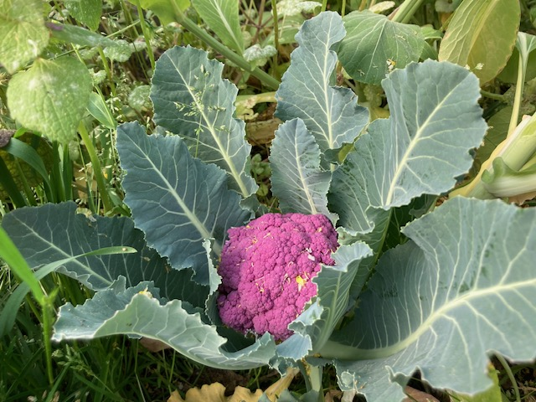
Annual Report
2021-2023
https://www.pwcpetersburg.org

Slide 2
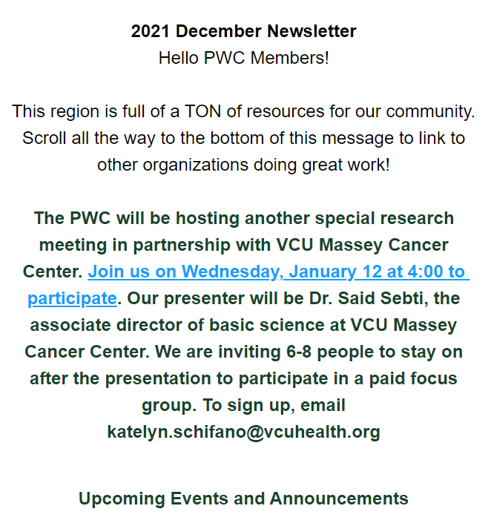
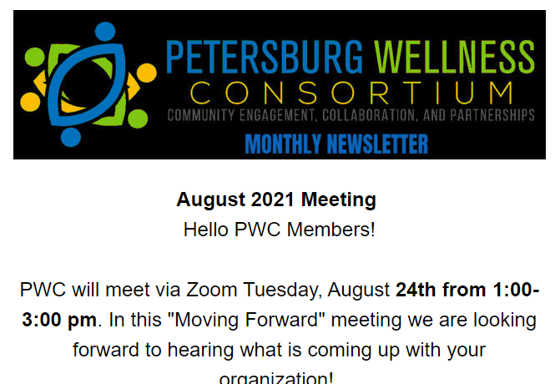
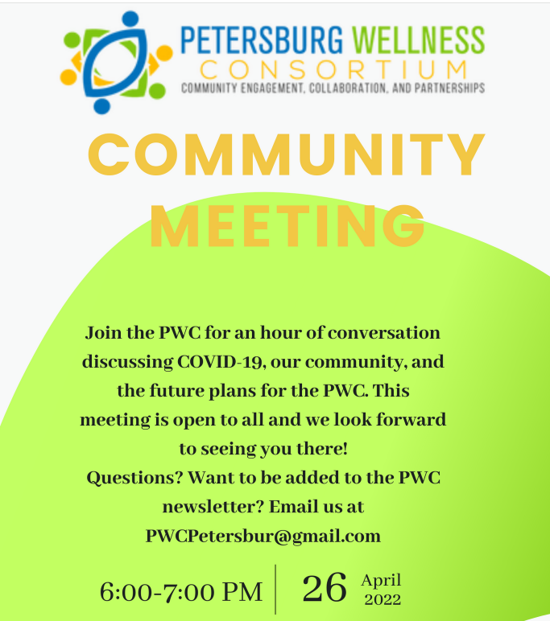
2021
Like the rest of the nation, PWC moved into the first full year of the COVID-19 pandemic holding meetings and events virtually and sharing information. From 2021 through 2023, e-newsletter distribution grew significantly. Subscribers received a total of 20 e-newsletters during those years. The e-newsletters were an important part of PWC's research meeting partnership with VCU Massey Cancer Center. They featured links to resources and event announcements.

Slide 3
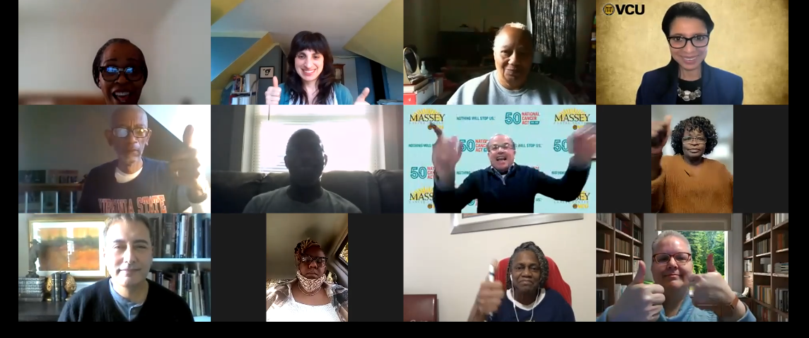
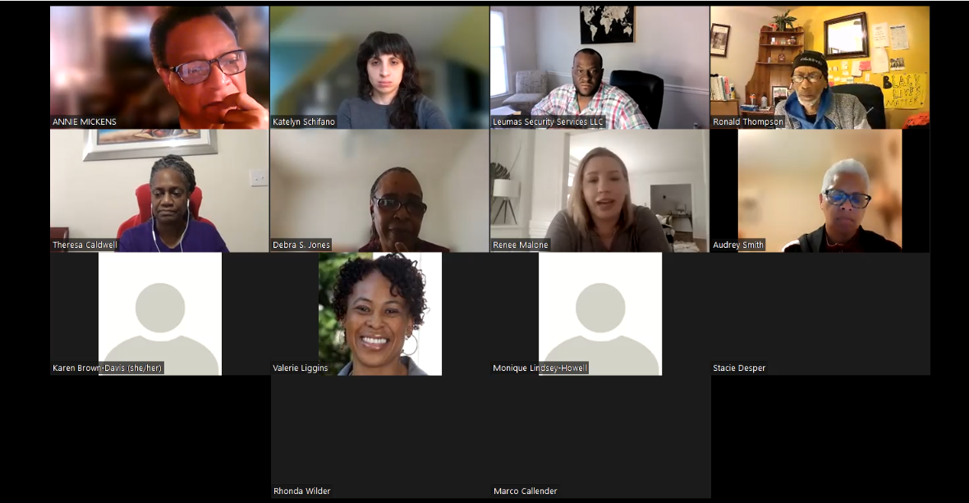
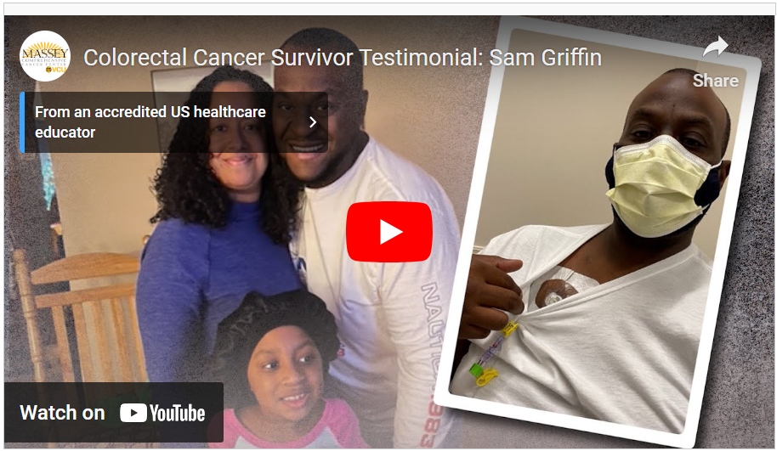
2022
General Body and Board meetings continued to work well for most of 2022. In fact, VCU Massey Cancer Center staff members who attended the March meeting in recognition of Colorectal Cancer Awareness Month were impressed by featured speaker Samuel Griffin III. Griffin was invited to give his testimonial in a VCU Massey Cancer Center video. PWC uses the Zoom platform.

Slide 4
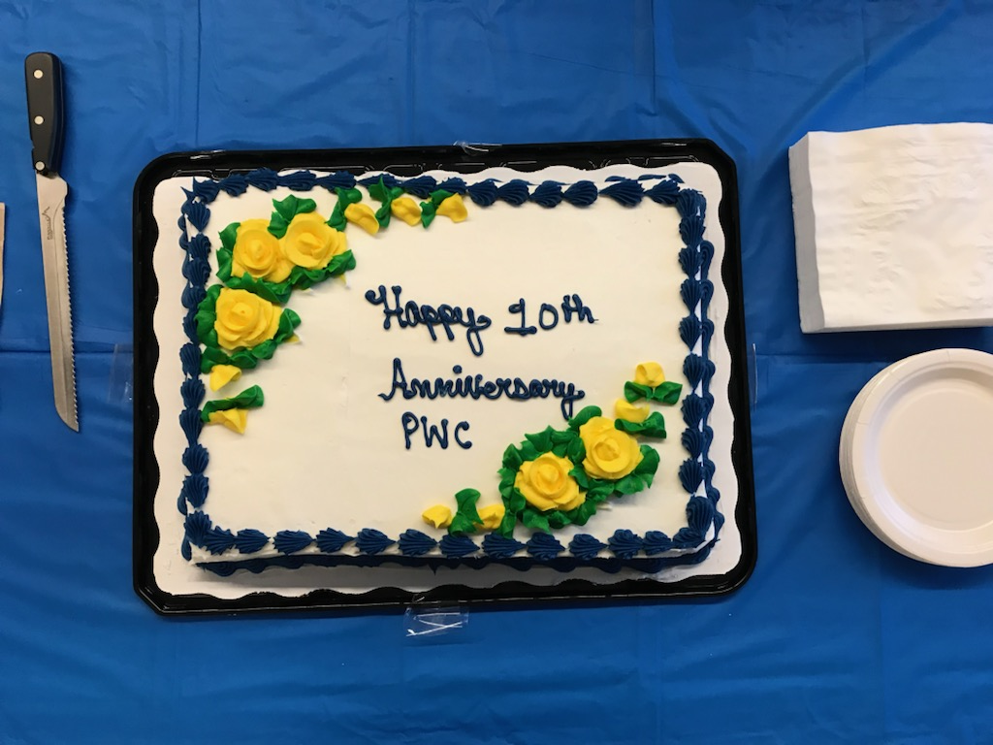
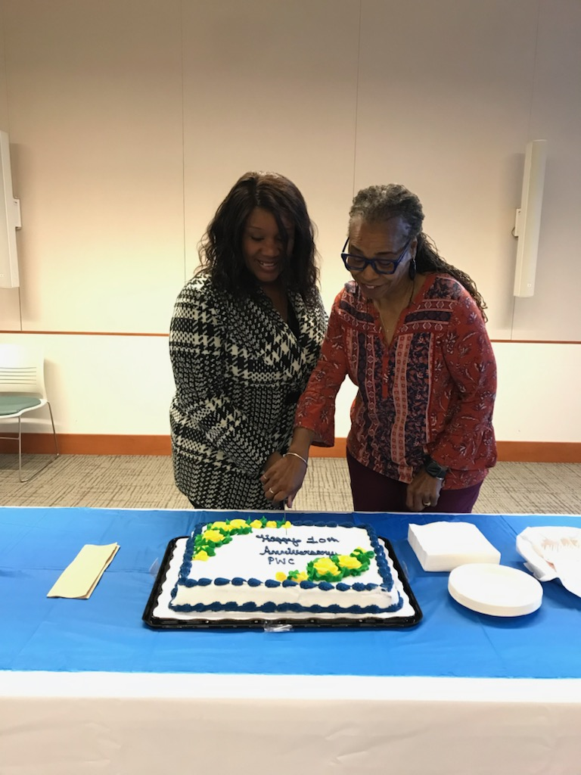

2022
A highlight of 2022 was celebrating PWC's 10 years serving as what Vice Chair Annie Mickens calls a "Community Connector." The Annual Meeting, held in October, included dinner, anniversary cake, and the transition of leadership. Outgoing PWC Chair Debbie Jones shared cake-cutting duties with incoming PWC Chair Monique Lindsey-Howell.

Slide 5
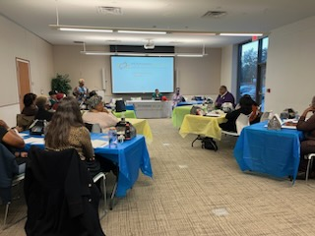
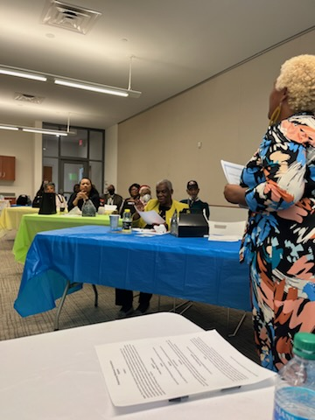
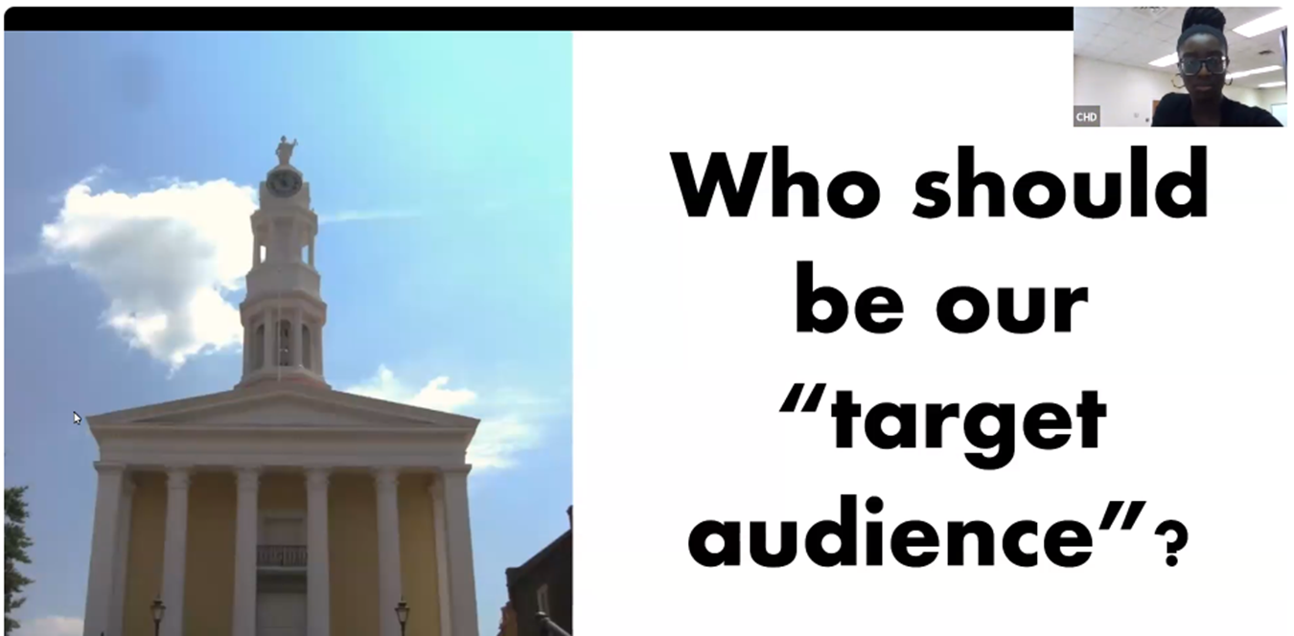
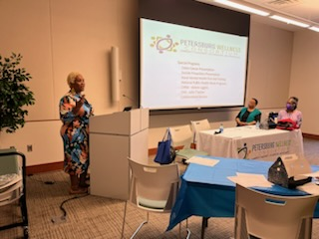
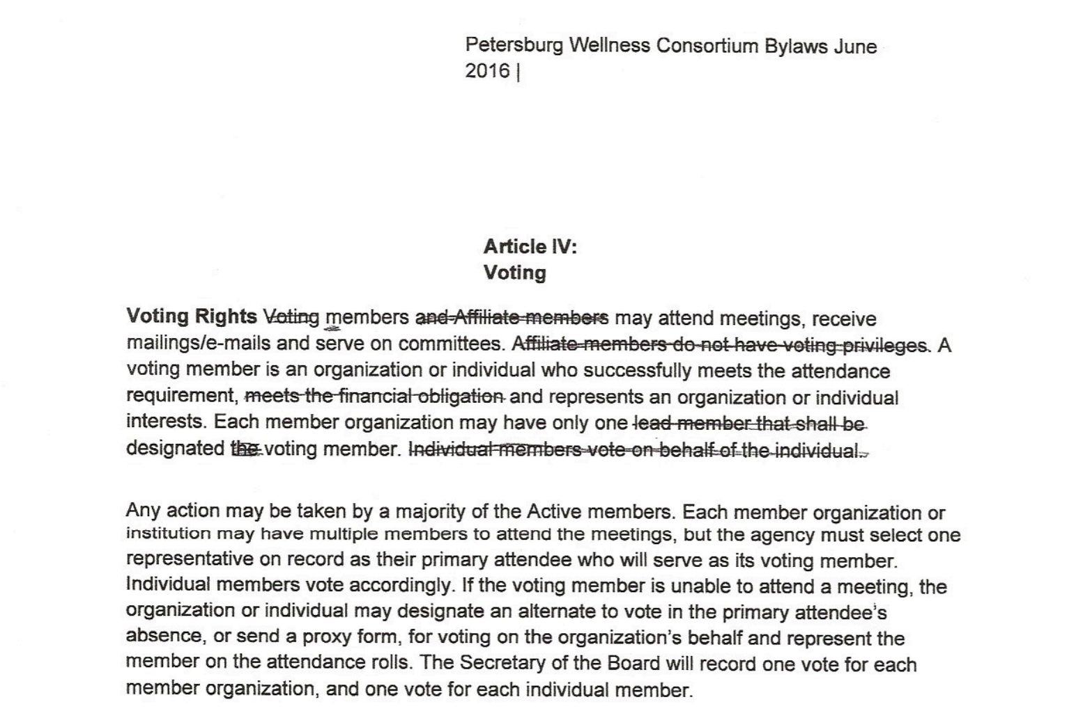
2023
PWC leaders spent much of 2023 in strategic planning sessions, which included updating the Bylaws. All Board Meetings moved to Zoom, and General Body Meetings became hybrid (participating in-person and online via Zoom). PWC Secretary Katelyn Schifano set the Zoom for 2023's Annual Meeting (right), moderated by PWC Chair Monique Lindsey-Howell.

Slide 6
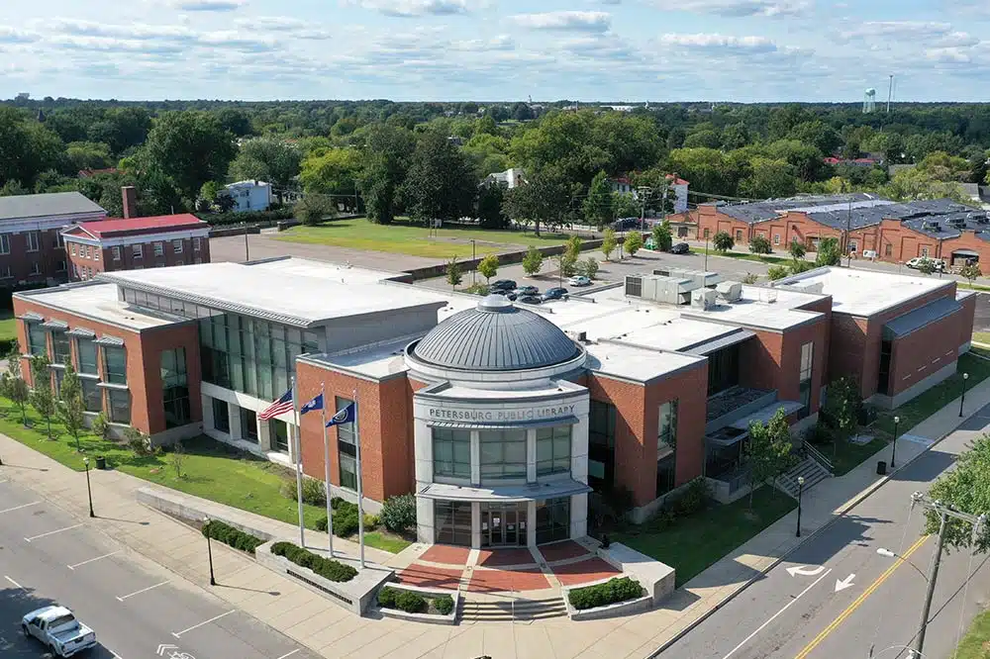
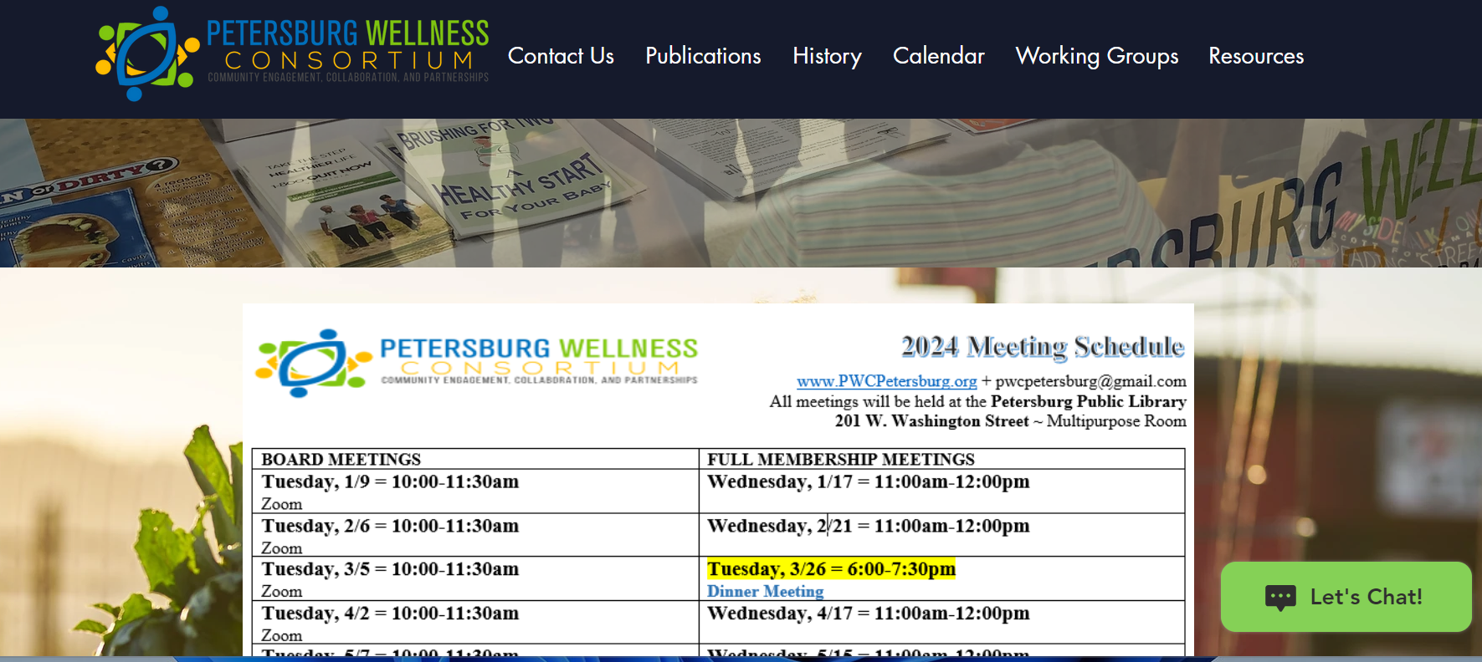
PWC's 2024 Board Meetings will be held virtually (via Zoom), and General Body Meetings will be hybrid. In-person General Body Meetings are in the Petersburg Public Library's Multipurpose Room, 201 W. Washington Street. Meetings are the 3rd Wednesday of the month at 11:00 a.m. Two evening meetings are scheduled, also at the Petersburg Public Library:
March 26th, 6:00-7:30 p.m.
October 22nd, 6:00-7:30 p.m. Annual Meeting
PWC ended 2023 with $12,242.75 in the its account with our Fiscal Sponsor, Pathways.
Efforts to gain 501(c)(3) non-profit status are on hold while the organization completes strategic planning, as well as updates to the Bylaws and Policies & Procedures.
Contact us: pwcpetersburg@gmail.com
LOOKING AHEAD
www.pwcpetersburg.com
Background photo: Petersburg Public Library

