Slide 1

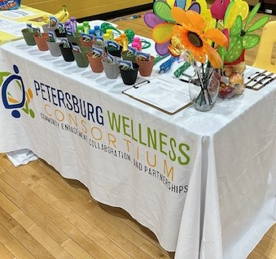
General Meeting
June 17, 2026
https://www.pwcpetersburg.org

Slide 2


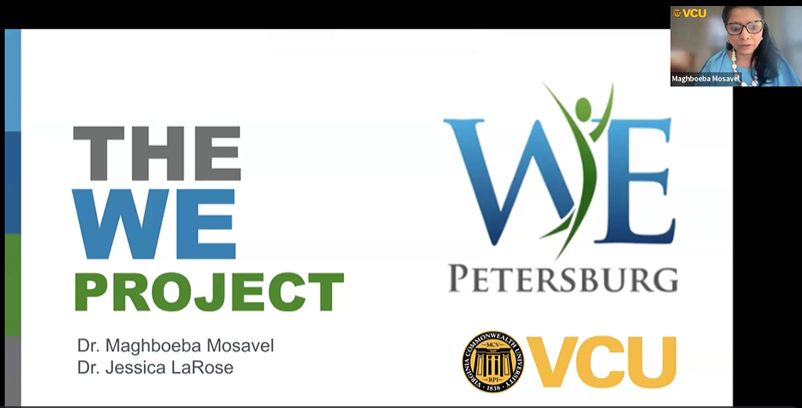
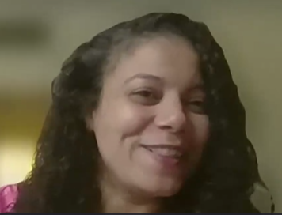
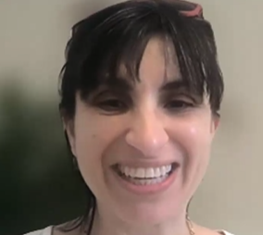

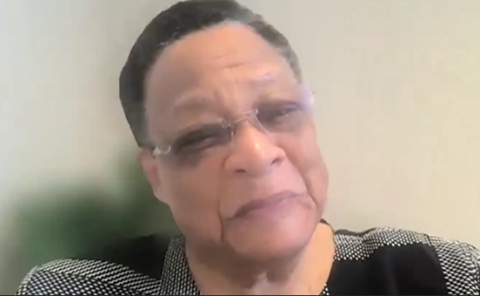
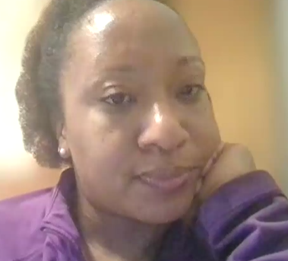

Meeting: May 20, 2026
The Wellness Engagement Project
Almost all PWC Meetings are hybrid. People attend via Zoom and in person.

Slide 3
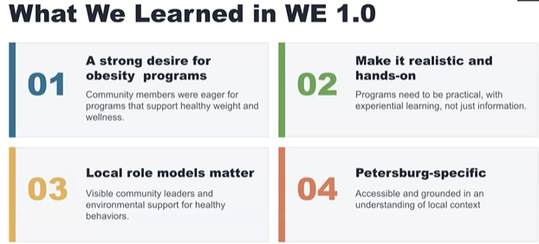
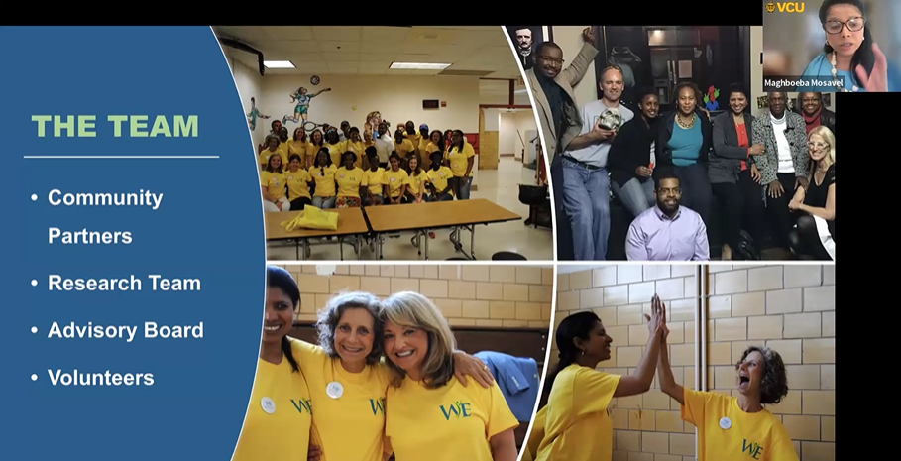

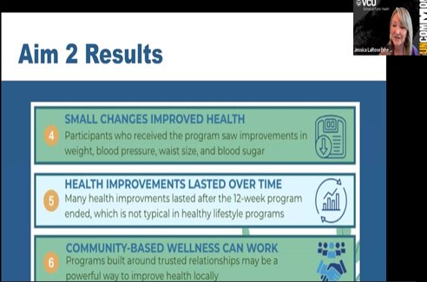

An update on the VCU research project that started in 2012 and helped launch the PWC.

Slide 4
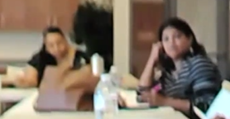
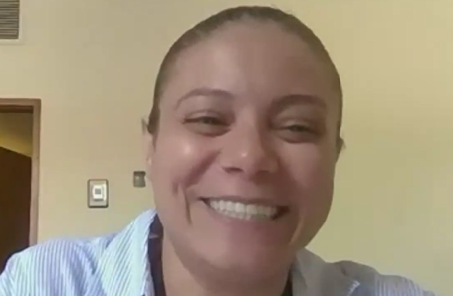
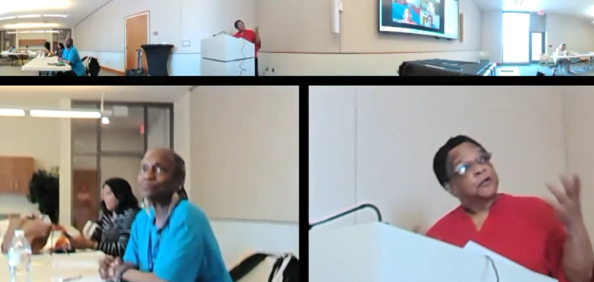
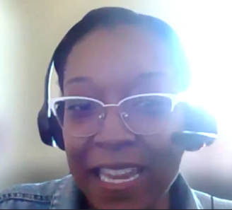
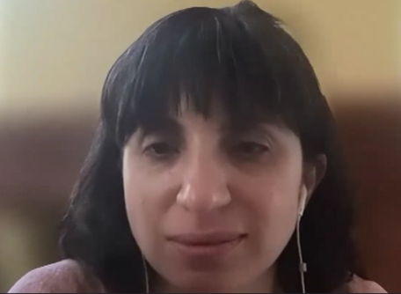

Meeting: April 15, 2026
Discussion: RHIP Strategic Issue #3. How can we connect to implement it?
People attended in person (Petersburg Public Library) and via Zoom. All meetings are hybrid.

Slide 5
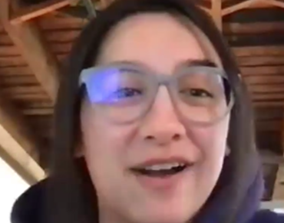

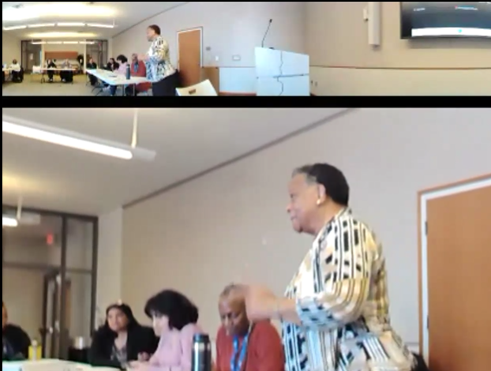
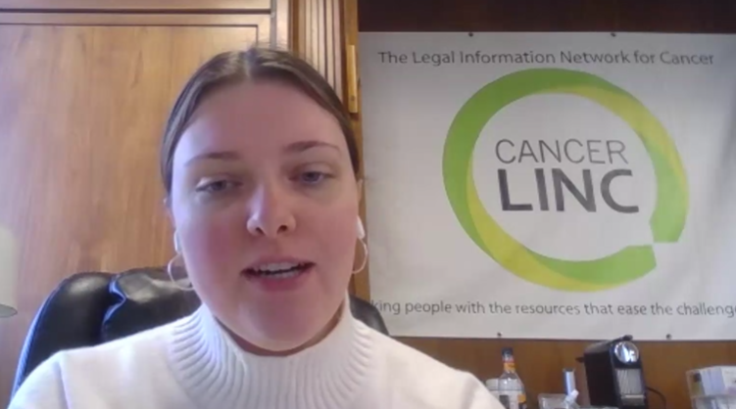
Meeting: March 18, 2026
Continued Conversation:
2026 PWC Goals and Objectives
Almost all PWC Meetings are hybrid. People attend via Zoom and in person.

Slide 6
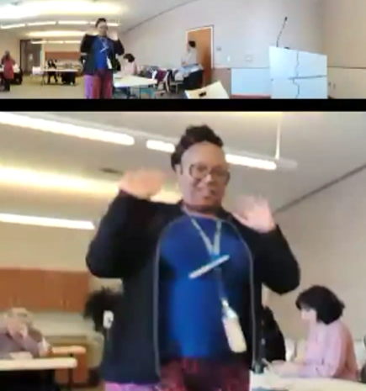
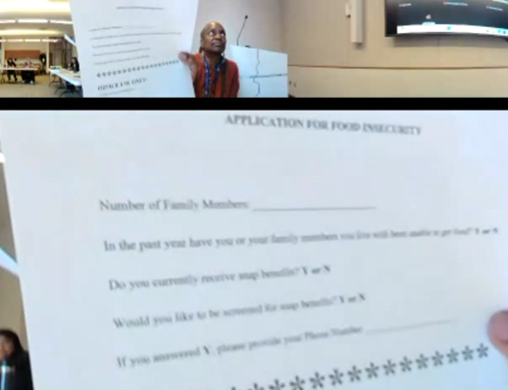
Robin Tyler, CVHS
Talked about food insecurity in Petersburg and shared an application CVHS uses for clients who need food support. This helped spark discussion about an event to help people with paperwork.

Slide 7
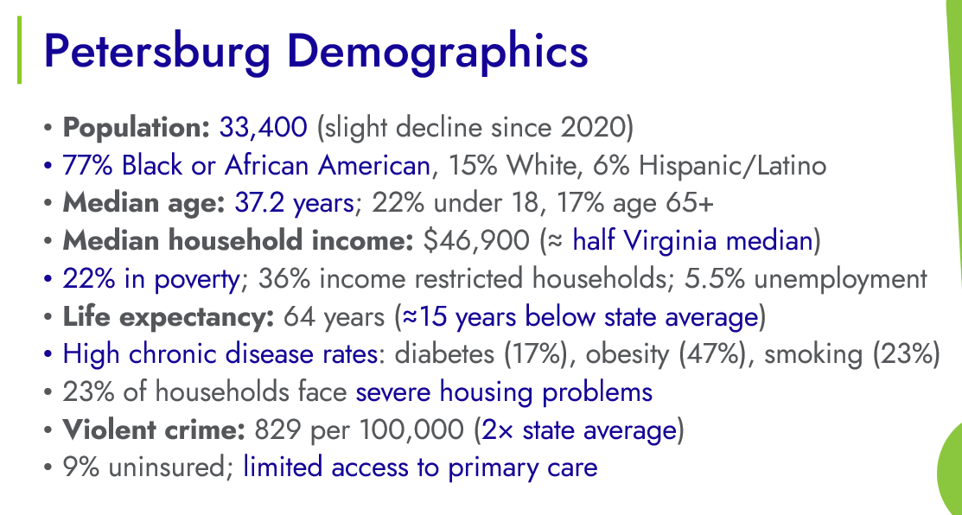

Meeting: February 18, 2026
Thank you KELLY EVANS for giving us an overview of IPHI's Petersburg casino Health Impact Assessment.

Slide 8
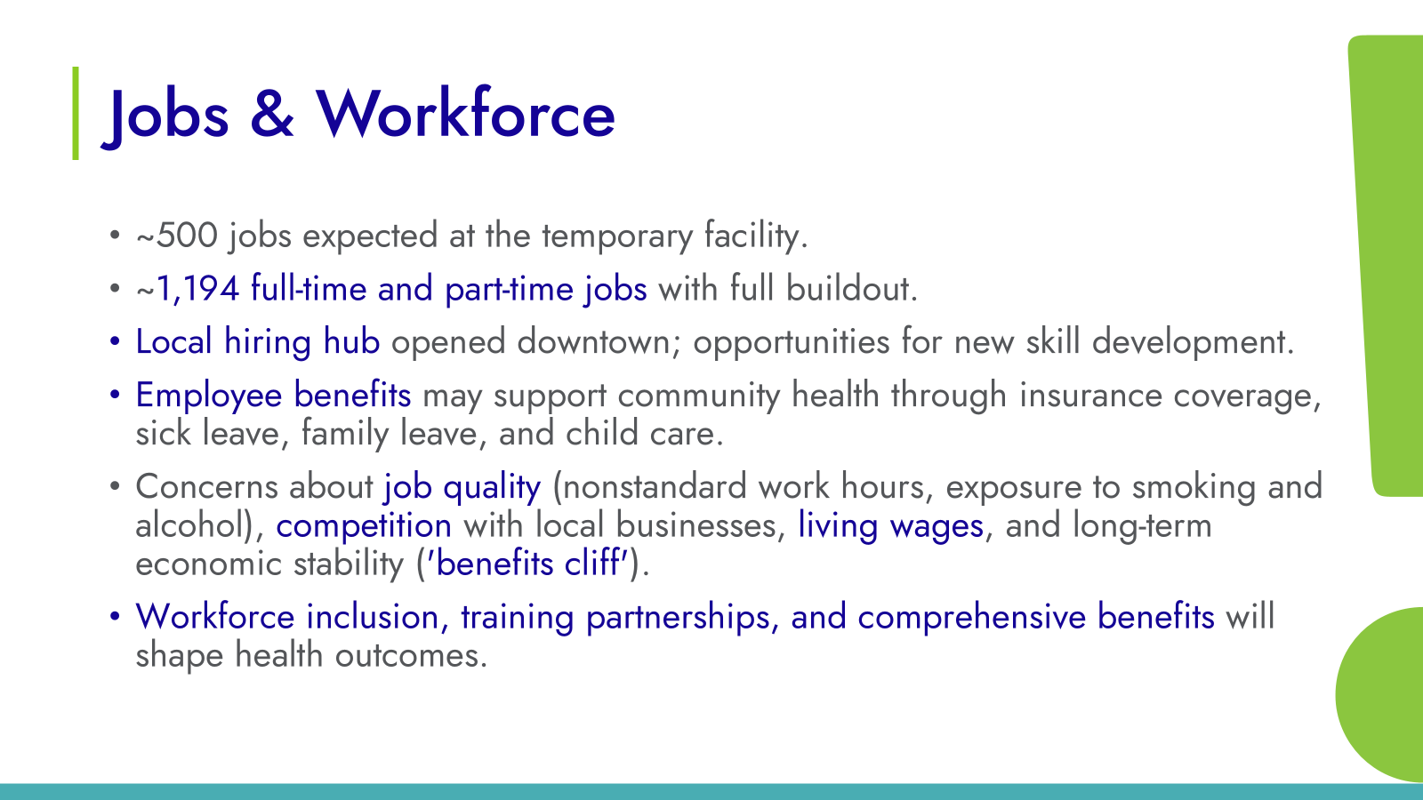
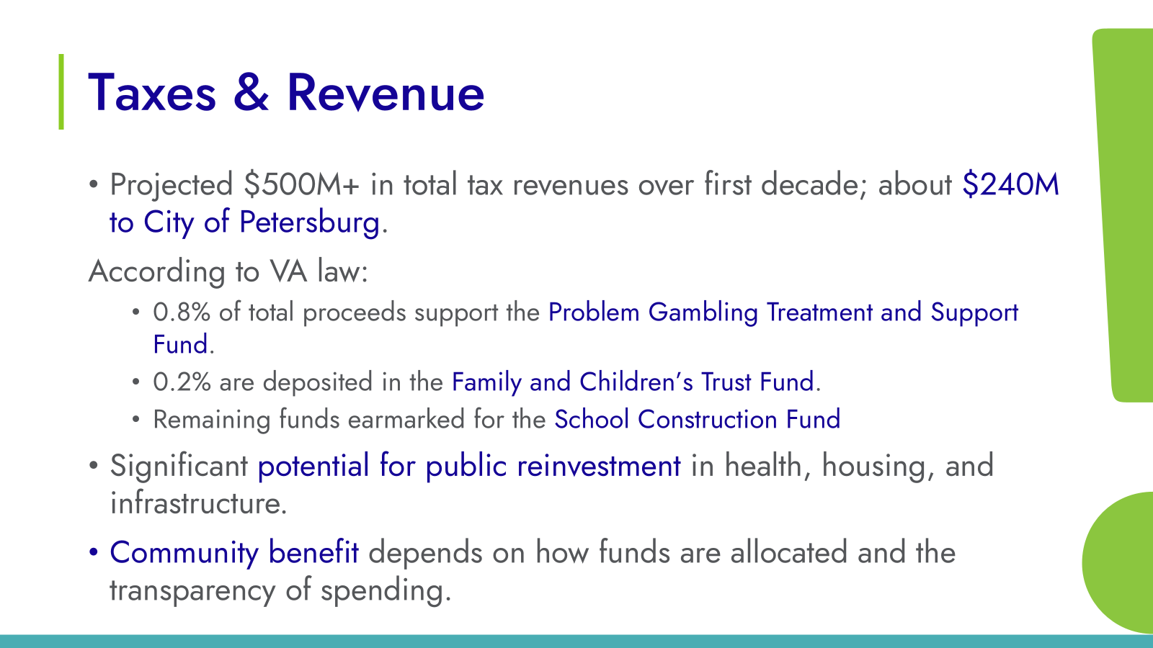
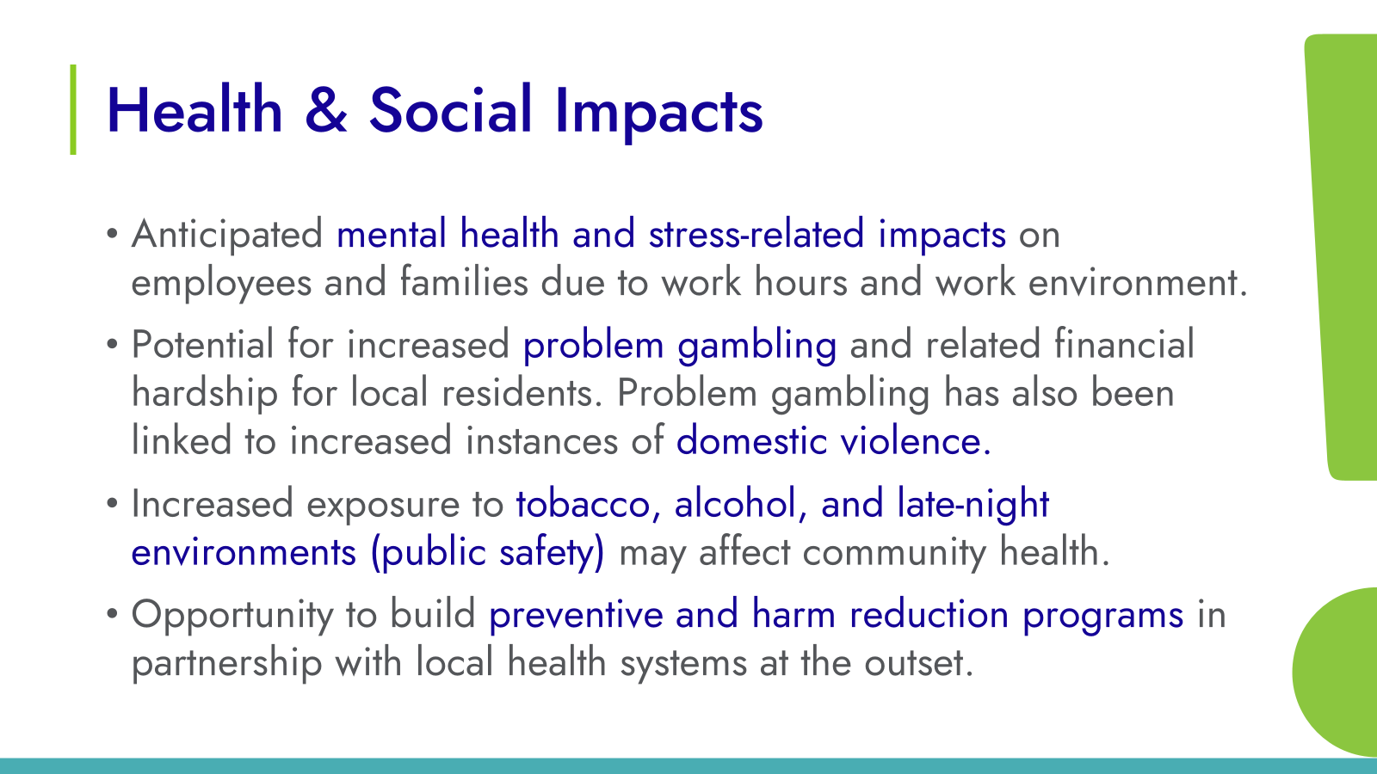

Slide 9
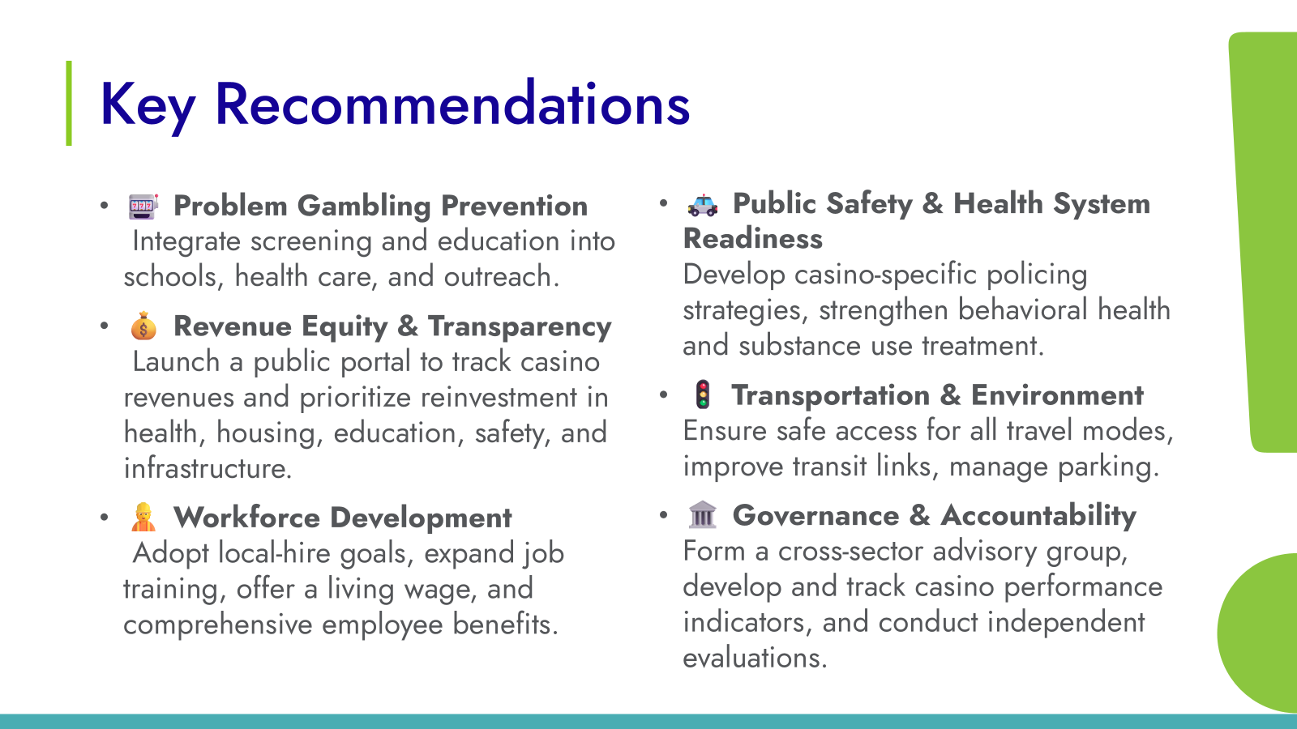

Slide 10
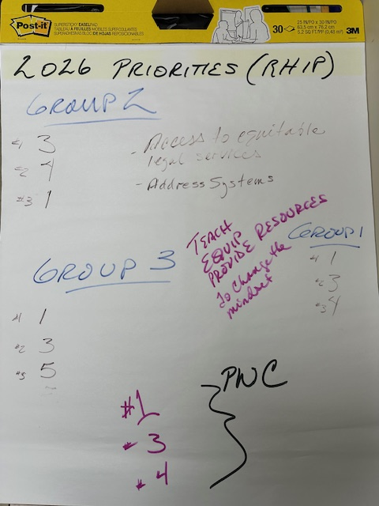
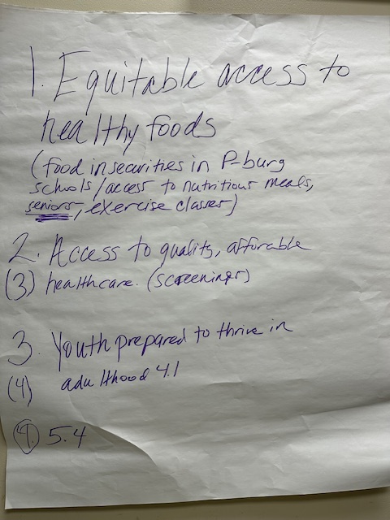
JANUARY 21, 2026
PWC's 2026 Priorities
As inspired by the Crater Regional Health Improvement Plan (RHIP)

Slide 11
2026 PRIORITIES
RHIP STRATEGIC ISSUE #1
EQUITABLE ACCESS TO HEALTHY FOODS
Increase accessibility, availability, and affordability of healthy foods to reduce food insecurity throughout the Crater region.
RHIP STRATEGIC ISSUE #3
ACCESS TO QUALITY AFFORDABLE HEALTHCARE, INCLUDING MEDICAL, DENTAL AND MENTAL HEALTHCARE
Increase utilization of available medical, dental, and mental healthcare services throughout Crater.
RHIP STRATEGIC ISSUE #4
YOUTH PREPARED TO THRIVE IN ADULTHOOD
Increase partnerships that provide opportunities for youth/young adults to access life skills education, including financial, workforce, social-emotional, health literacy, etc.

Slide 12
WORKING TOGETHER TO BUILD HEALTH AND WELLNESS
IN PETERSBURG
Launched in 2012, PWC is an alliance of stakeholders working to ensure the collective strength of resources are used to empower the community and strengthen the culture of health in Petersburg.
Thank You for joining us!
www.PWCPetersburg.org

Slide 13
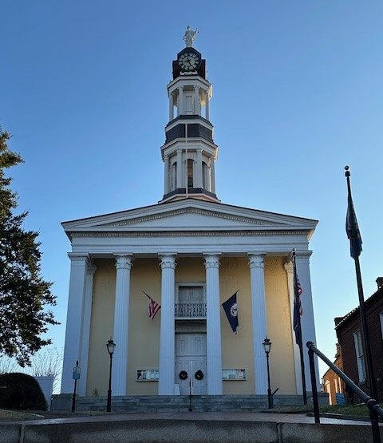
NEXT MEETING
WEDNESDAY, AUGUST 19th
Petersburg Public Library's Multipurpose Room, 201 W. Washington Street.
General Meetings: 3rd Wednesday of the month, January-September (except July), 11:00am.
2026 ANNUAL DINNER MEETING:
October 27th, 6:00-7:30pm
www.pwcpetersburg.com
pwcpetersburg@gmail.com

