Slide 1

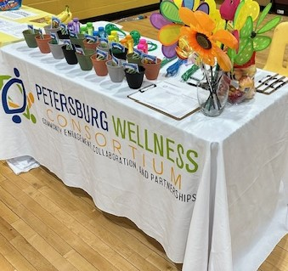
Annual Report
2025
https://www.pwcpetersburg.org

Slide 2
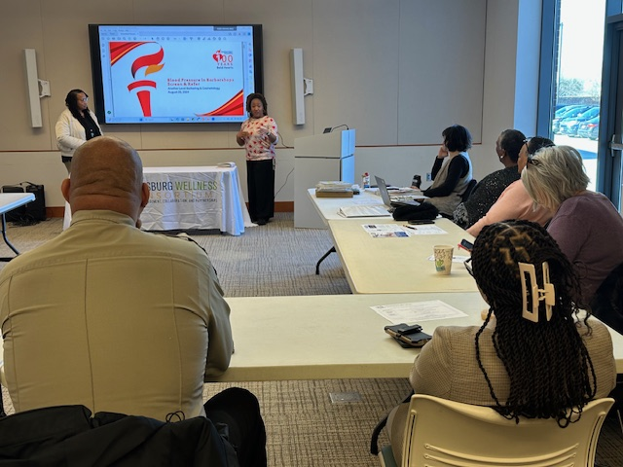
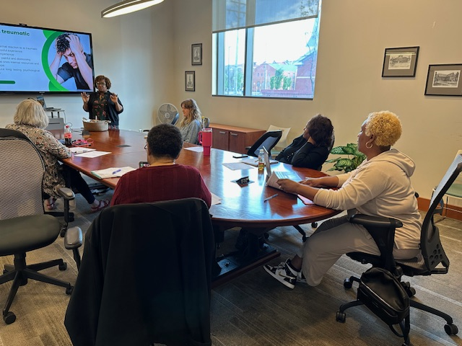
2025
The Petersburg Wellness Consortium (PWC) held seven (7) full membership meetings in various formats: in-person/virtual (hybrid). The August meeting was cancelled so members could support the VDH-Crater Health District release of the Crater Regional Health Improvement Plan (RHIP).
The PWC Board continued work on the organization's administrative infrastructure as a fully functioning 501(c)(3) nonprofit.

Slide 3

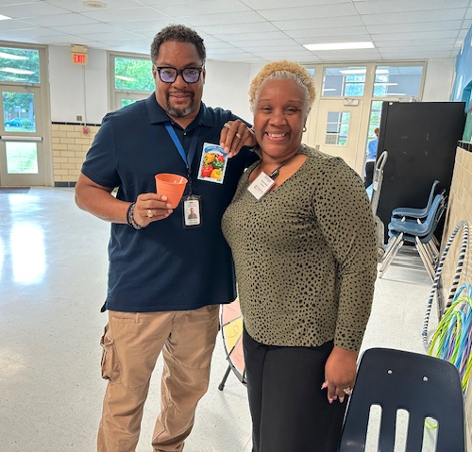
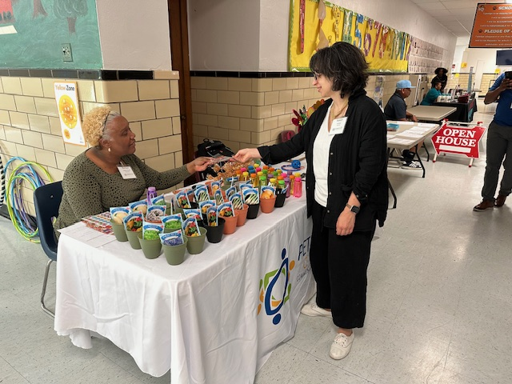
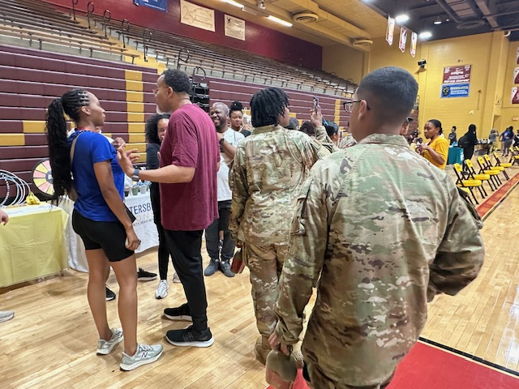
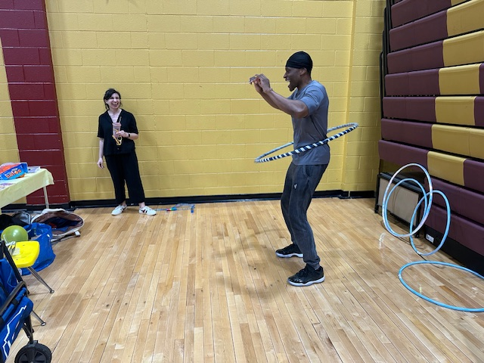
2025 featured several expanded opportunities to interact with people who live, learn, work, play, and pray in Petersburg. Those efforts were significantly supported by the Virginia Commonwealth University (VCU) Massey Comprehensive Cancer Center Community Engagement Partnership Grant. PWC was awarded the grant in 2024.

Slide 4
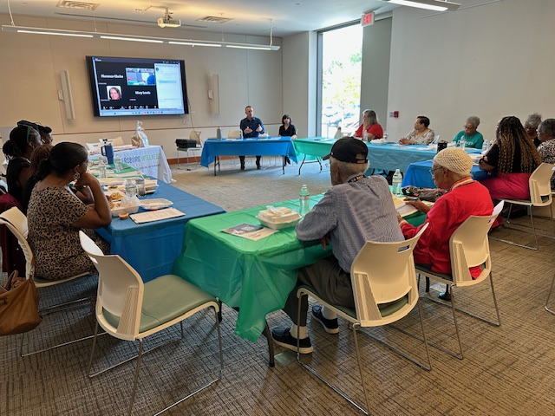
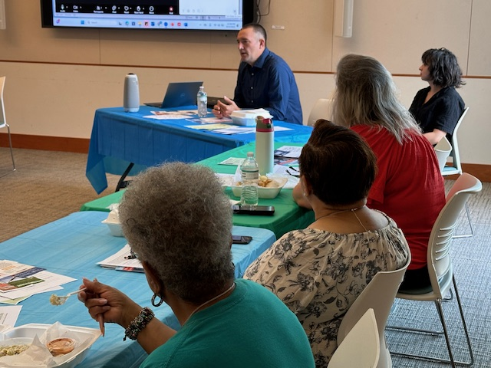
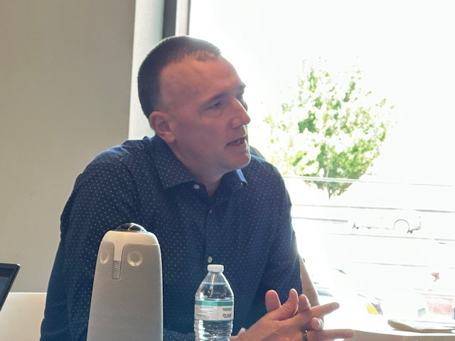
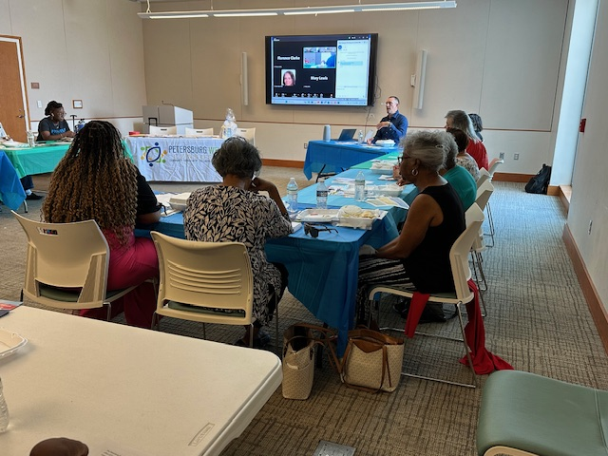
In addition to community experiences supported by the $10,000 grant, there was the PWC Presents: VCU Researchers and Real Talk series. It started on August 14 with Dr. Alexander Lucas, and his conversation about the relationship between fitness and your ability to prevent and/or fight cancer. Pro tip: Stand up after reading this.

Slide 5
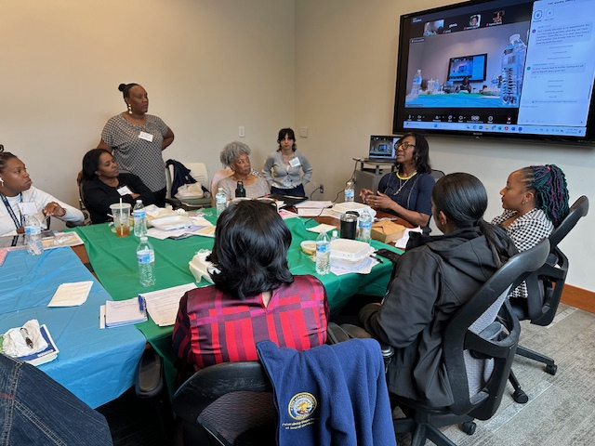
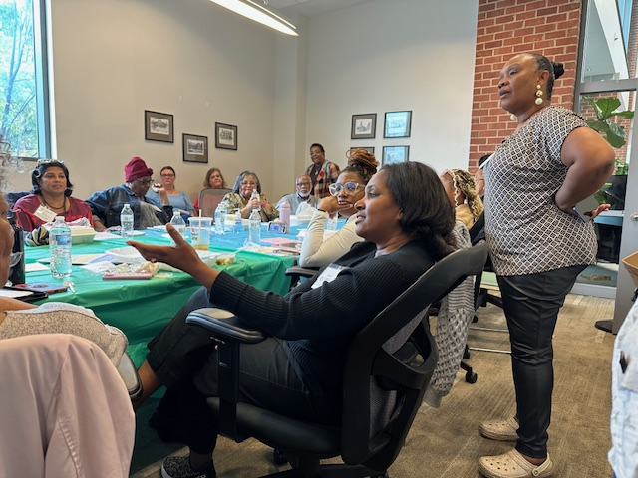
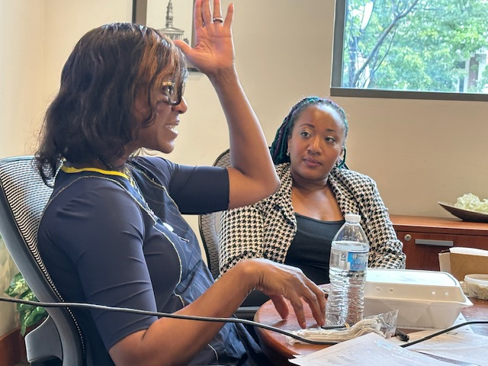
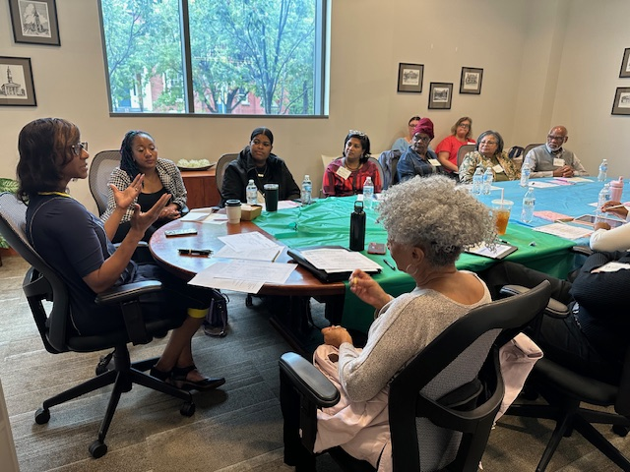
On September 17 Dr. Vanessa Sheppard, winner of the American Cancer Society's 2022 Researcher of the Year Award, led a relaxed conversation about ways to get the most out of your time with your doctor. This was said to be especially important when it comes to major health challenges like cancer. Dr. Sheppard and Dr. Lucas led sometimes emotional conversations that created space for participants to ask questions about personal issues.

Slide 6
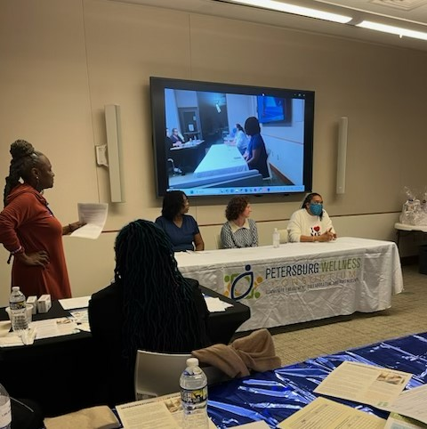
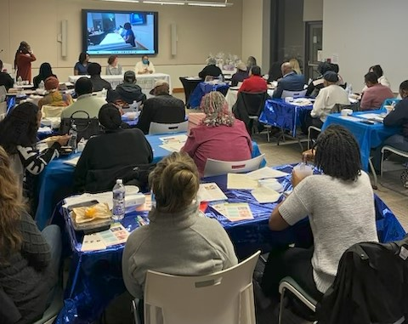
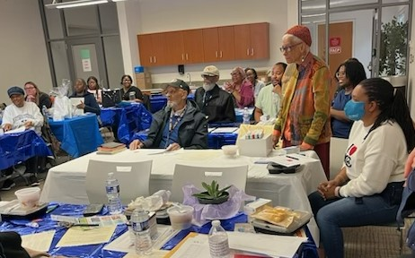
ANNUAL MEETING 2025
The VCU grant also supported the October 28 Annual Meeting and Dinner. The featured panel continued the "Real Talk" series by addressing the relationship between oral health and overall health. The panel: VCU's Dr. Molly Bristol; Regina Dixon, VDH Dental Health Program-Crater Health District; Altise Street, DentaQuest.

Slide 7
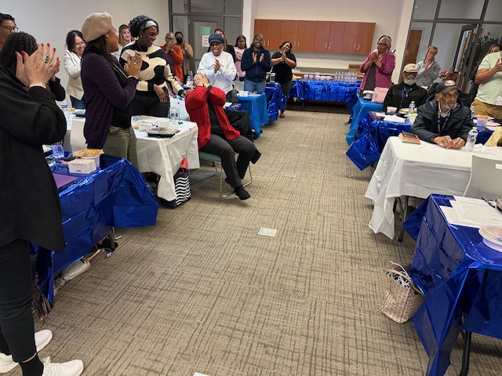
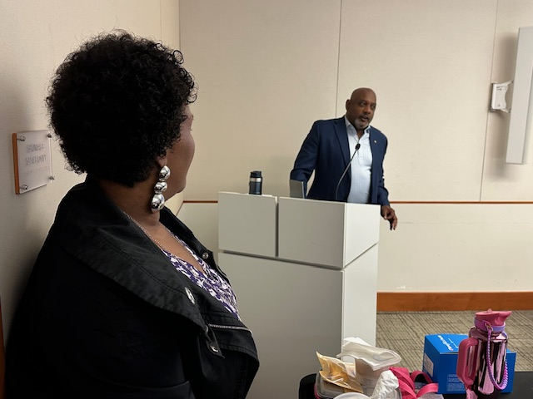
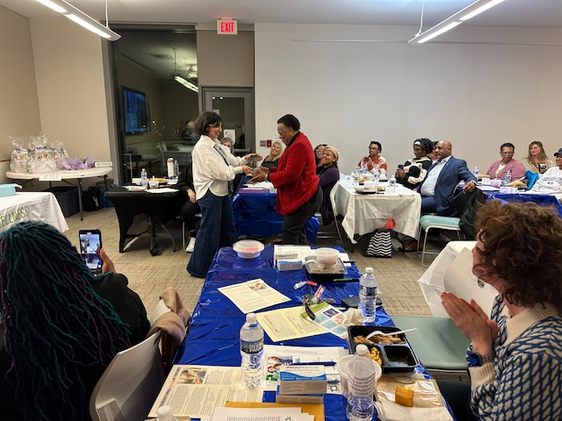
ANNUAL MEETING 2025
During the meeting, PWC announced the first Annie Mickens Award for Community Excellence. It was launched in honor of the beloved community servant, former mayor, former teacher and lifelong educator, and PWC's Vice Chair. Ms. Mickens was surprised by the award, and the presence of her son and two nieces.

Slide 8
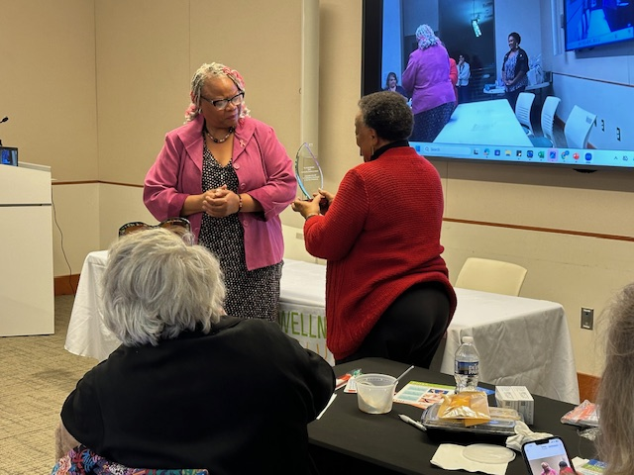
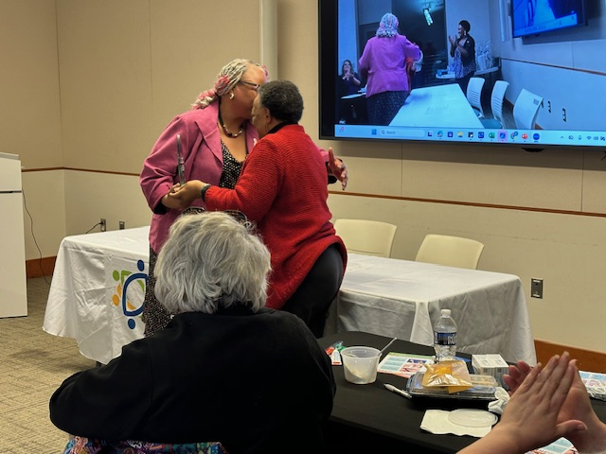
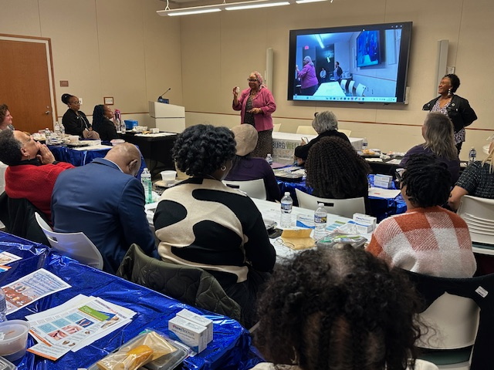
ANNUAL MEETING 2025
Ms. Mickens presented the award to Jackie Zemmitt for her tireless service to those in need. After more than 30 years in various roles at the Department of Social Services, Zemmitt is still known for serving with joy, grace and compassion. She also continues to inspire countless women by sharing her breast cancer journey.

Slide 9
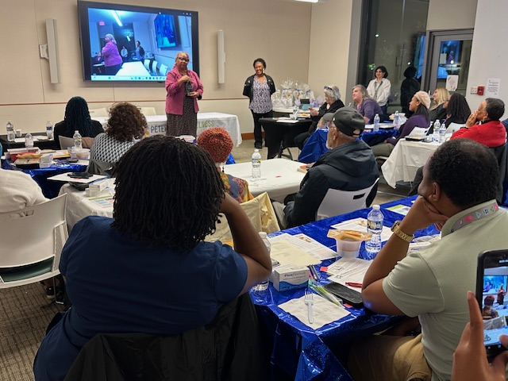
As of December 31, 2025, PWC had $10,095.67 in its accounts with People's Advantage Credit Union: $9,349.97 is held in savings, $745.70 in checking.
Board Members engaged JP Consulting, Inc., of Prince George for accounting services, and West Bend Insurance Company for directors and officers insurance.
PWC Board: Monique Lindsey-Howell, Chair; Annie Mickens, Vice-Chair; Theresa Caldwell, Treasurer; Katelyn Schifano, Secretary; Members: Phoenecia (Neci) Hill, Joanne Johnson, Tara Rose, Robin Tyler.
Up Next: Updating the Resource Guide and website.
LOOKING AHEAD
www.pwcpetersburg.com
pwcpetersburg@gmail.com

Slide 10
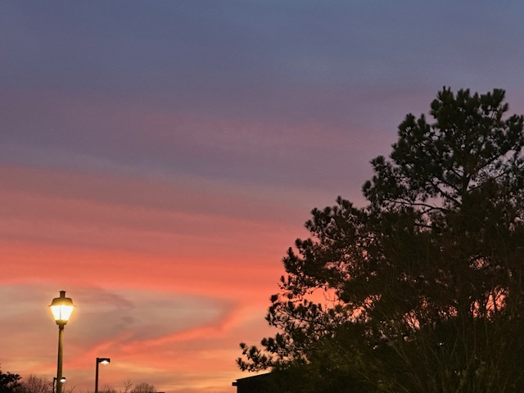
In 2026, PWC will continue holding in-person full membership meetings in the Petersburg Public Library's Multipurpose Room, 201 W. Washington Street. There will continue to be a Zoom option. Monthly Board Meetings will be held via Zoom.
General Meetings: 3rd Wednesday of the month, January-September (except July), 11:00am.
Evening Meeting: October 27 Annual Meeting and Dinner. 6:00-7:30pm
LOOKING AHEAD
www.pwcpetersburg.com
pwcpetersburg@gmail.com

Slide 11
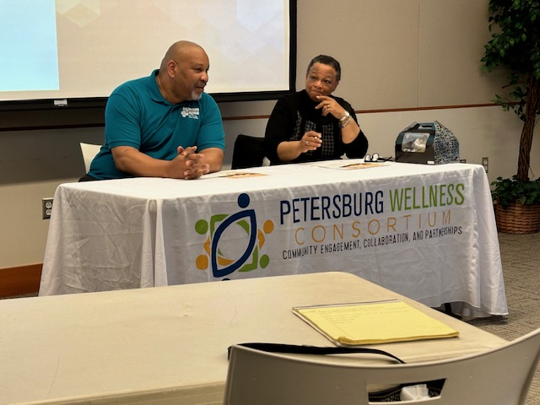
Remembering our friend
DR. BOBBY DUHART
The beloved pediatrician and community advocate was the featured speaker at our Dinner Meeting on March 26, 2024. He's pictured here with PWC Vice Chair Annie Mickens.
Dr. Duhart passed away in September, 2025.

